Slide 1

Financial Data Analysis
Using Microsoft power bi
BY :- SUBHASISH GHOSH

Slide 2
CONTENTS
INTRODUCTION
Overview
Questions
Dashboard
Insights
conclusion

Slide 3
INTRODUCTION
Welcome to My Financial Dataset!
This comprehensive collection includes detailed records of transactions, account balances, and market
trends. It’s designed to provide valuable insights into:
Financial Performance: Track and evaluate the financial health of business.
Investment Patterns: Understand and analyze trends in investments.
Economic Indicators: Assess key indicators to gauge economic conditions.
Analyzing Cash Flows: Understand inflows and outflows for better liquidity management.
Assessing Risk: Evaluate financial risks to make informed decisions.
Forecasting Future Trends: Predict upcoming financial scenarios and prepare strategies accordingly.

Slide 4
overview
This presentation explores a financial dataset containing key metrics for various companies:
Serial Number - Unique identifier for each company.
Name of Company - Company name.
Mar Cap Crore - Market capitalization in crores.
Sales Qtr. Crore - Quarterly sales in crores.

Slide 5
Questions
Using power bi my aims to
Identify top companies by market capitalization and sales.
Analyze the distribution of market capitalization vs sales.
Calculate the market capitalization to sales ratio.
Top 5 company ratio.
Use Cards or Gauge visuals to show total market cap, total sales, average market cap, and average sales.

Slide 6
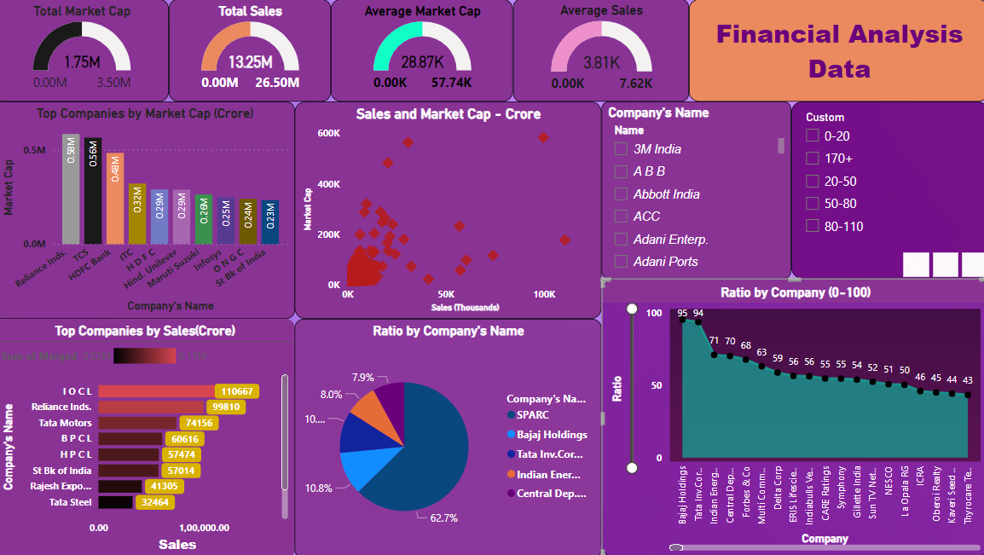
Dashboard

Slide 7
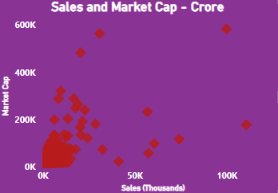
Insights
Identify top companies by market capitalization
Identify top companies by sales
Name | Sum of Mar Cap - Crore
Reliance Inds. | 583436.72
TCS | 563709.84
HDFC Bank | 482953.59
ITC | 320985.27
H D F C | 289497.37
Hind. Unilever | 288265.26
Maruti Suzuki | 263493.81
Infosys | 248320.35
O N G C | 239981.5
St Bk of India | 232763.33
Name | Sum of Merged
I O C L | 110666.9
Reliance Inds. | 99810
Tata Motors | 74156.07
B P C L | 60616.36
H P C L | 57474.25
St Bk of India | 57014.08
Rajesh Exports | 41304.84
Tata Steel | 32464.14
TCS | 30904
Larsen & Toubro | 28747.45
Analyze the distribution of market capitalization vs sales.
Top 5 company ratio.
Name | Sum of Ratio
SPARC | 553.8172
Bajaj Holdings | 95.34667
Tata Inv.Corpn. | 93.61251
Indian Energy Ex | 70.97606
Central Dep. Ser | 70.20131

Slide 8
conclusion
My analysis of the financial dataset using Power BI provides valuable insights into the market performance of various companies. By identifying top companies by market capitalization and sales, analyzing distribution trends, and calculating the market capitalization to sales ratio, I can better understand market dynamics. Highlighting growth trends in sales further aids in strategic decision-making. These insights enable stakeholders to make informed business decisions based on data-driven analysis.

Slide 9


